Slide 1
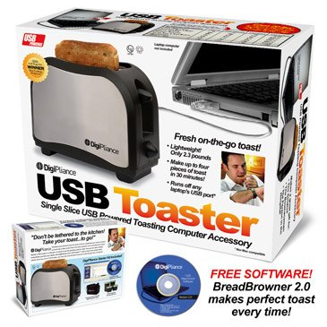
Risk Benefit Analysis for Toast-USB Launch
Nijia Ke, Nicholas Mobley, Allison McCarty
04/01/2021

Slide 2
Outline
Introduction
Data processing
Comparisons of the two samples
Exploratory data analysis
Data Modeling
Application of model to determine a Manufacturer suggested Retail Price (MSRP)
Conclusions

Slide 3
Introduction: Data
5 major metropolitan areas
Sample 1: 421 observations of 8 variables; 50.36% in favor
Sample 2: 45,211 observations of 17 variables; response rate?
Break-even response rate: 24.13%

Slide 4
Introduction: Specific Aims
Specific Aim 1: To compare the demographic features of the two samples qualitatively and quantitatively.
Specific Aim 2: To recommend on whether the client should move forward with the campaign and provide suggestions on campaign strategies.
Specific Aims 3: To determine a Manufacturer Suggested Retail Price (MSRP) which optimizes revenue.

Slide 5
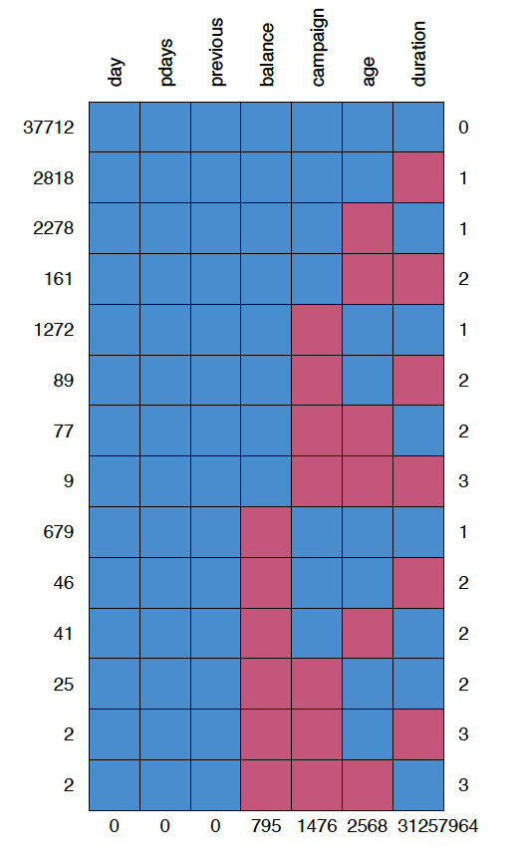
Data Processing
17216 (38.10%) ≥1 missing values
Categorical variables (“Unknown”)
Numeric variables
439 (0.97%) ≥2 missing num. variables
Missing at random
Replace missing values with the medians

Slide 6
Comparisons of the Two Samples
Age
Balance
Job
Education
Marital status Mortgage Primary phone
Variables common in both samples:
2 numeric variables
5 categorical variables
Credit in default
Personal
loan
Delinquency
Gender
Race

Slide 7
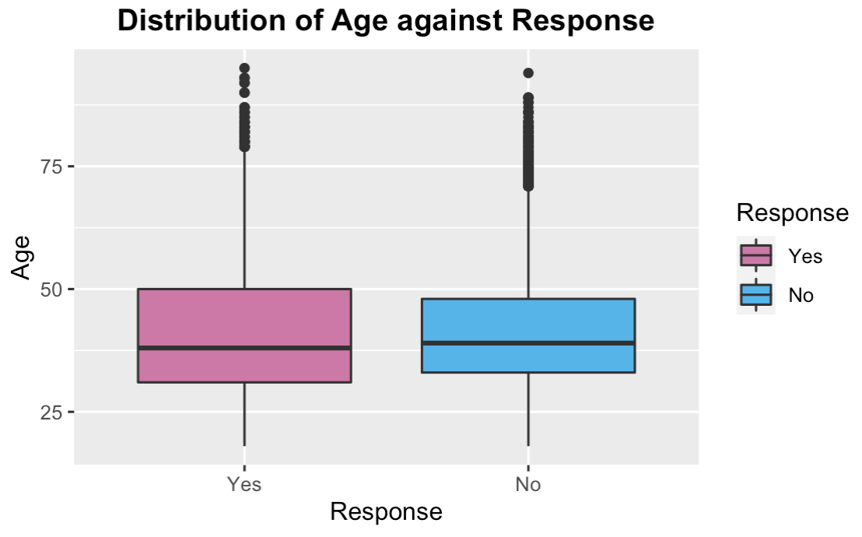
Age vs. Response
95% Confidence
Interval (sample 2)
Yes: 23 to 74
No: 25 to 60
Means (sample 1)
Yes: 25.5
No: 37.5

Slide 8
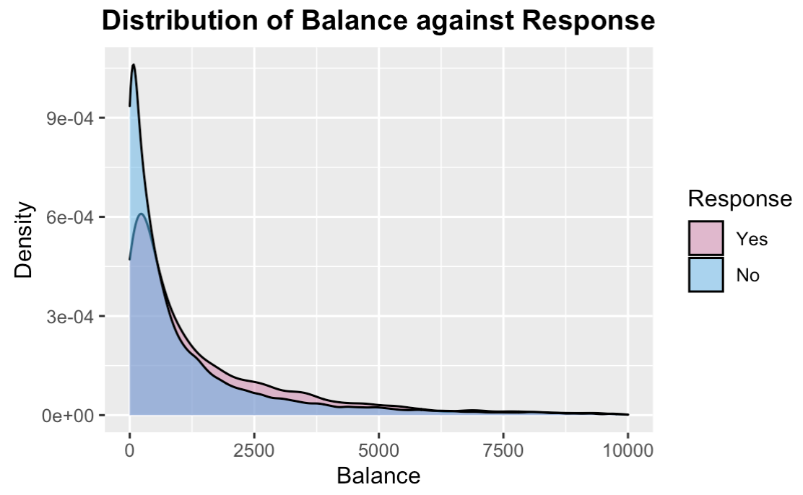
Non-mortgage Loan Balance vs. Response
95% Confidence
Interval (sample 2)
Yes: -$157.45 to $10185
No: -$393 to $8266
Means (sample 1)
Yes: $1250
No: $23879

Slide 9
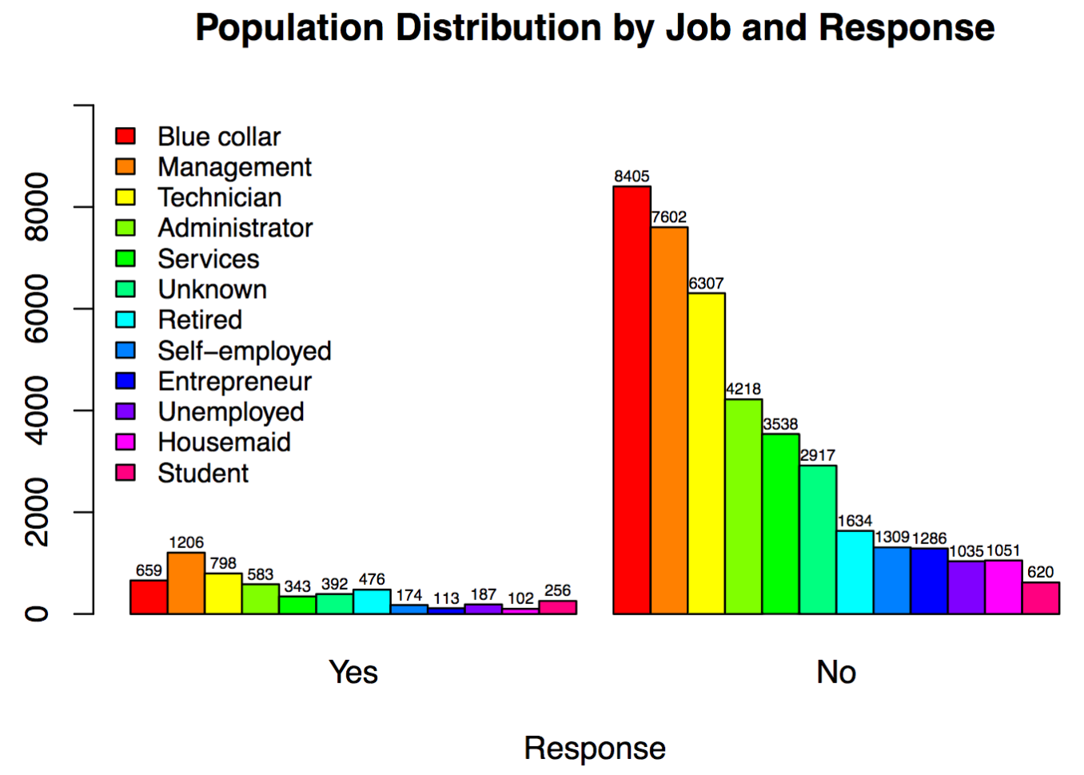
Job vs. Response
Most responds no
Common: Blue collar, Management, Technician
Uncommon: Housemaid and Student

Slide 10
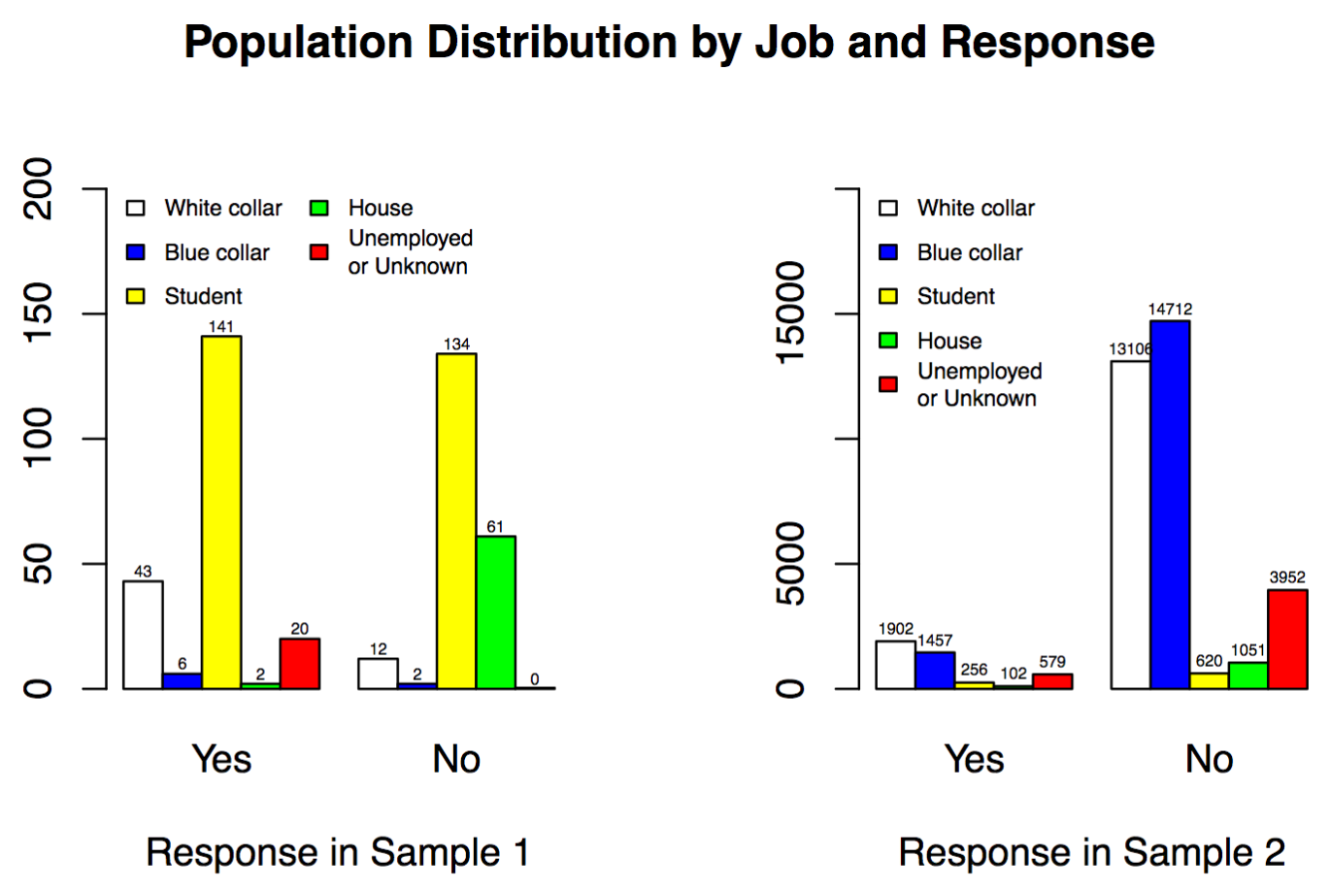
Job vs. Response in Two Samples
Sample 1: most are students, hardly any blue collars
Only housemaids behave similarly in
both samples

Slide 11
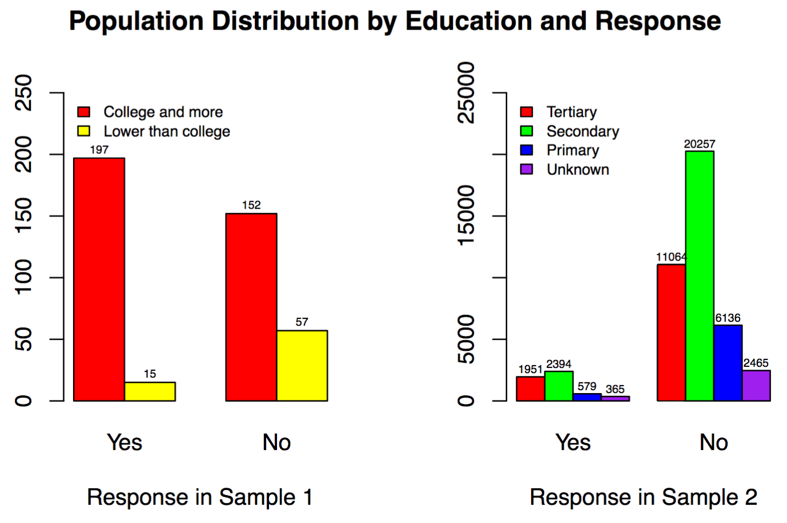
Education vs. Response in Two Samples
College and more = Tertiary
Lower than college = Secondary + Primary
Sample 1: College and more has more response in favor

Slide 12
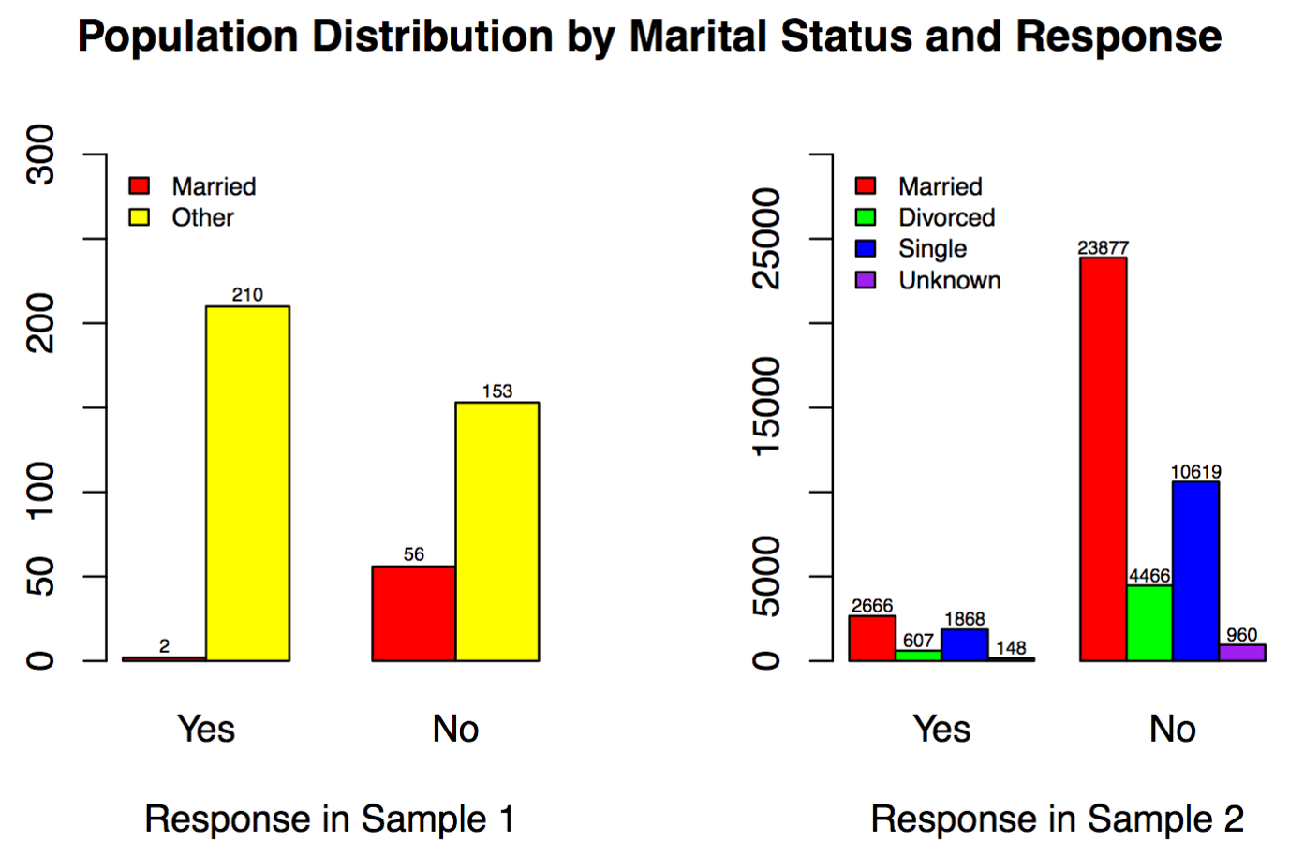
Marital Status vs. Response in Two Samples
Other = Divorced
+ Single + Unknown
Sample 1: married are limited
Married respondents not willing to buy

Slide 13
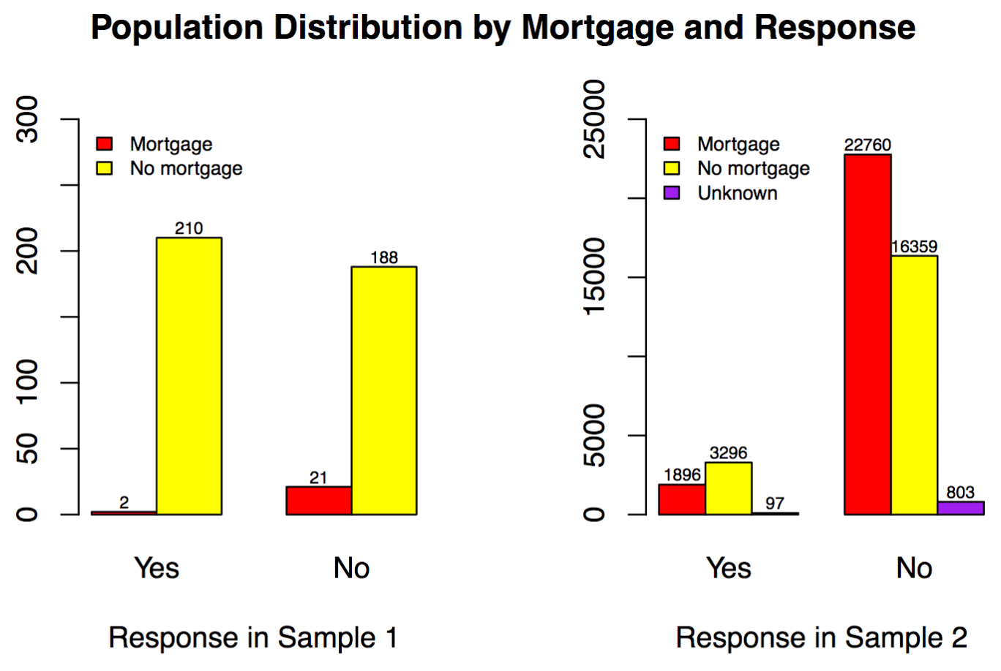
Mortgage vs. Response in Two Samples
Sample 1: fewer respondents with mortgage
Mortgage: Less likely to buy
No mortgage: respond in conflicting trends

Slide 14
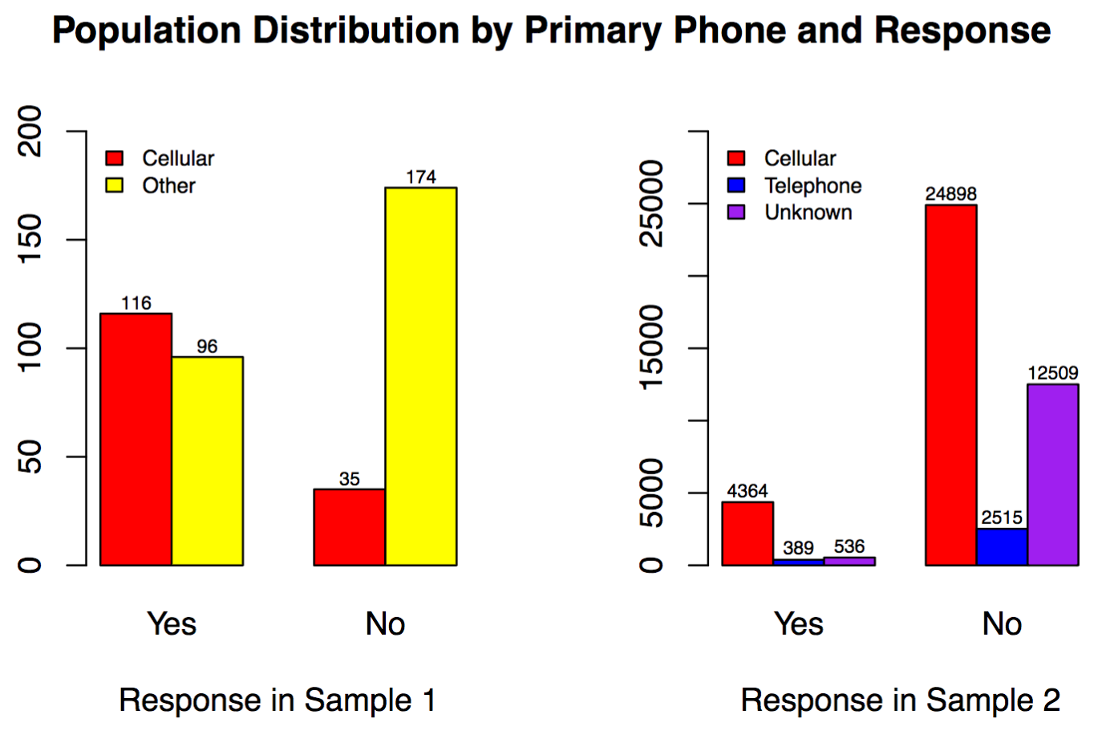
Primary phone vs. Response in Two Samples
Other = Telephone
+ Unknown
Cellular
Sample 1: ≤ 1/2
Sample 2: ≥ 1/2
Respond in opposite tendencies

Slide 15
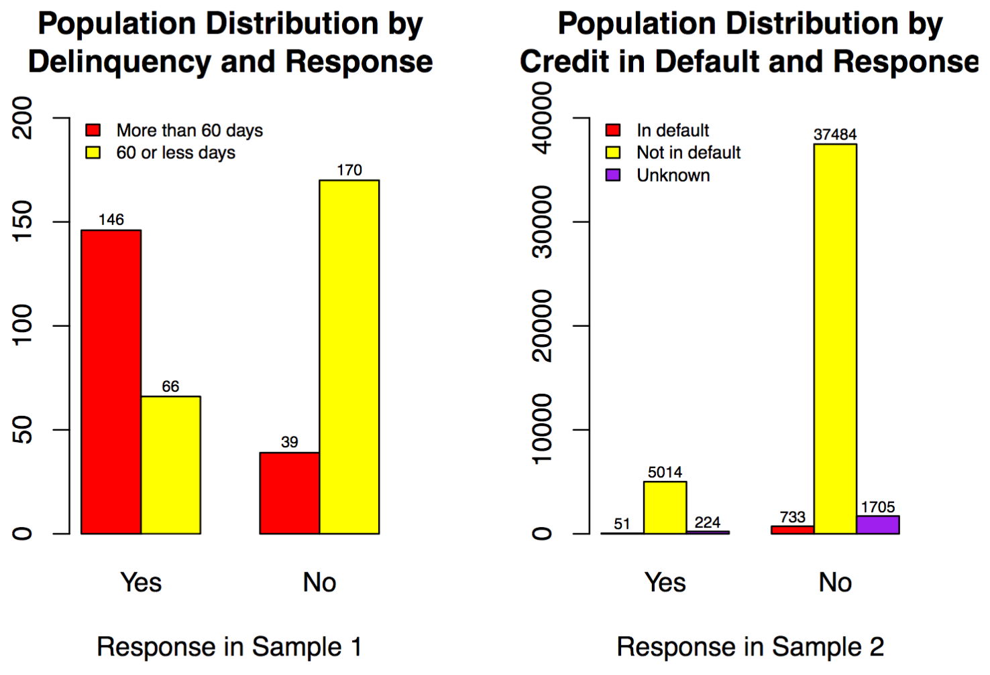
Delinquency vs. Credit in Default
Delinquency ≈ Credit in Default
Sample 2: the majority are not in default
Similar response trend

Slide 16
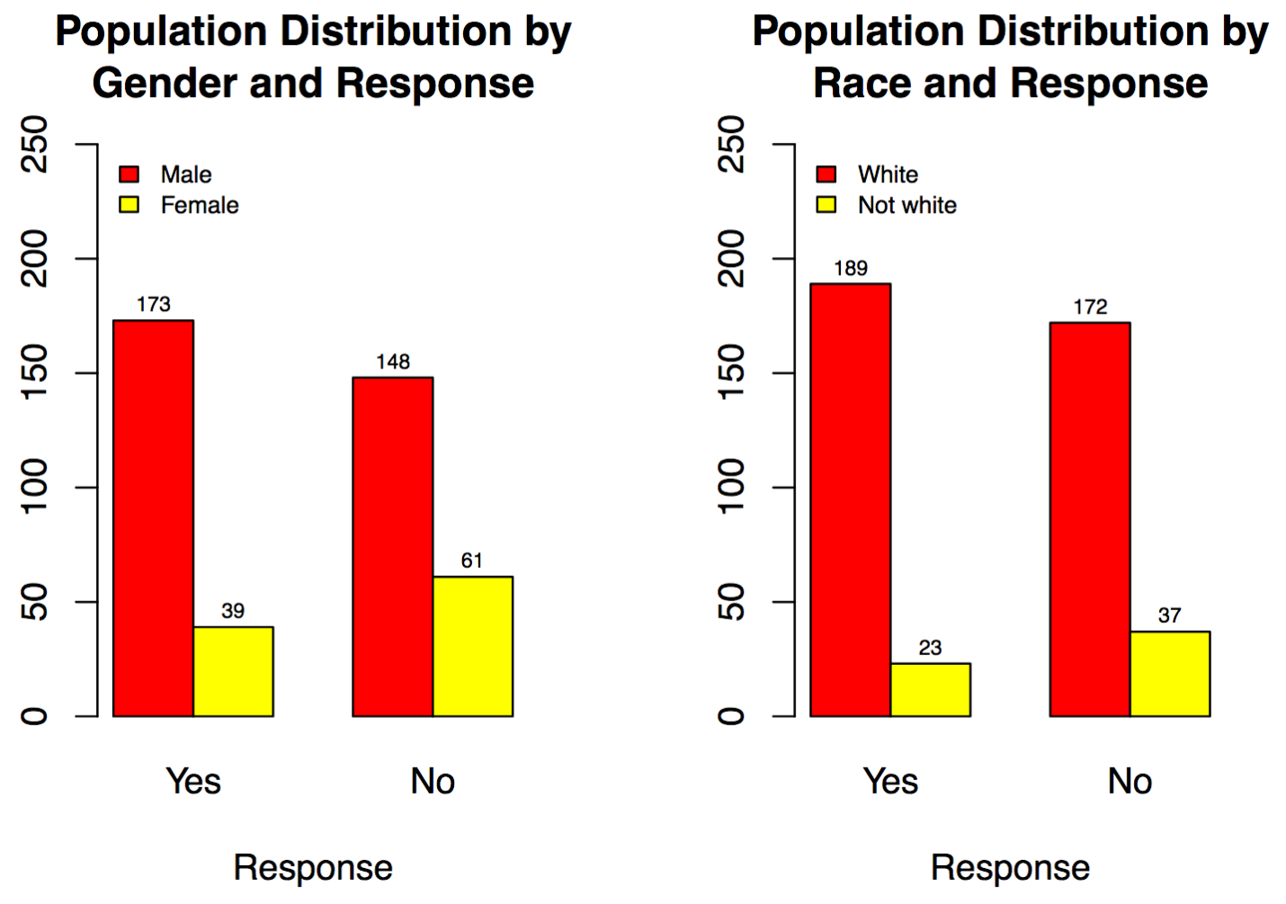
Gender vs. Race in Sample 1
Male and White are overrepresented
Similar patterns of response for both Gender and Race

Slide 17
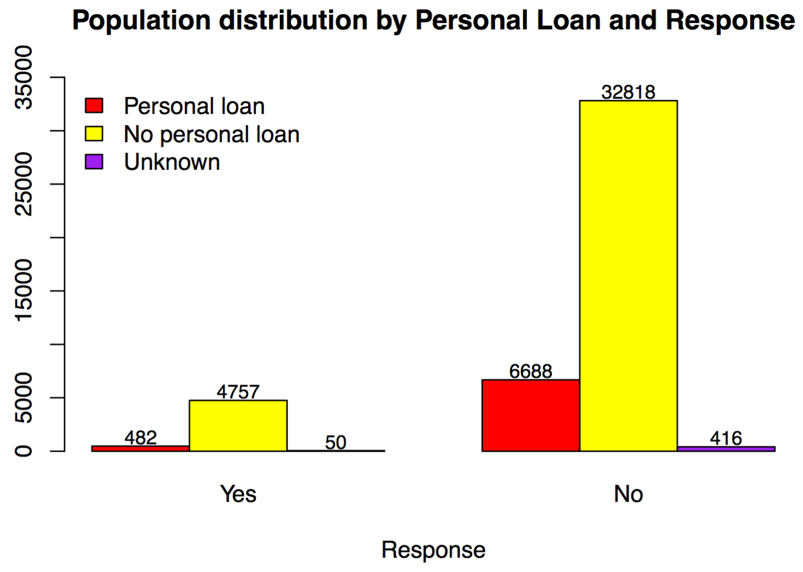
Personal Loan vs. Response in Sample 2
Regardless of having personal loan or not, respondents both tend to not buy the product

Slide 18
Results of Likelihood Ratio Tests
Sample 1: Response is significantly associated with Job, Education, Marital status, Mortgage, Primary phone, Delinquency, Gender and Race
Sample 2: Response is significantly associated with Job, Education, Marital status, Mortgage, Primary phone, Credit in default and Personal loan
Sample 1 and Sample 2 (5 variables in common): not from the same population

Slide 19
Summary: Comparisons of the Two Samples
Variables | Overrepresented | underrepresented
Job | Student | Blue collar
Education | College and more
Marital status |  | Married
Mortgage |  | With mortgage
Primary phone |  | Cellular

